Slide 1
Open Questions and Research Tools in Nuclear Astrophysics
Lecture 2: neutron stars
and the equation of state
Liliana Caballero
University of Guelph

Slide 2
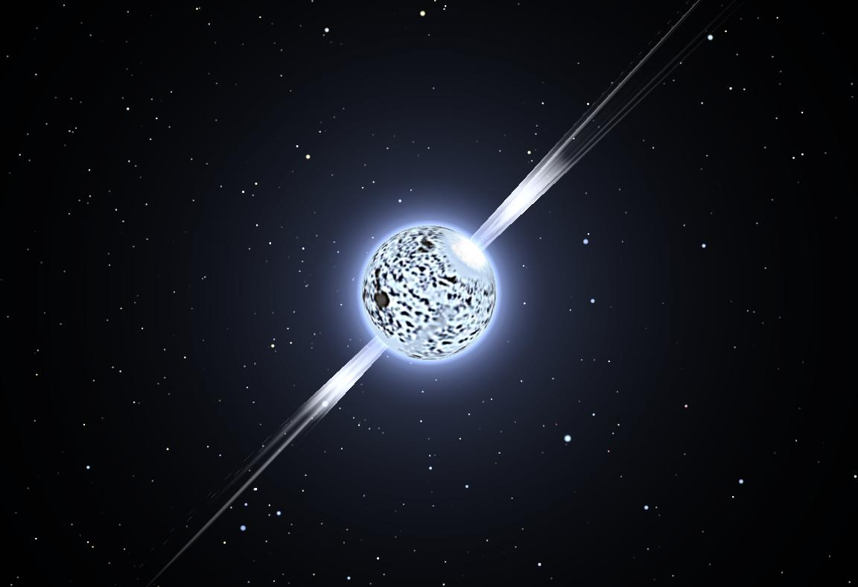
Neutron stars
End of life of a heavy star ( 8 times heavier than our Sun).
Born when gravity overpowers thermonuclear pressure: Supernova.
Neutrinos (elementary particles) carry away huge amounts of energy.

Slide 3
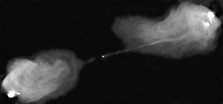
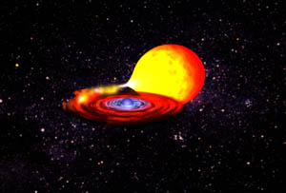
Neutron star crust observables
Gravitational Waves
Pulsars, radio map of Cygnus A made with the VLA
X-ray bursts

Slide 4
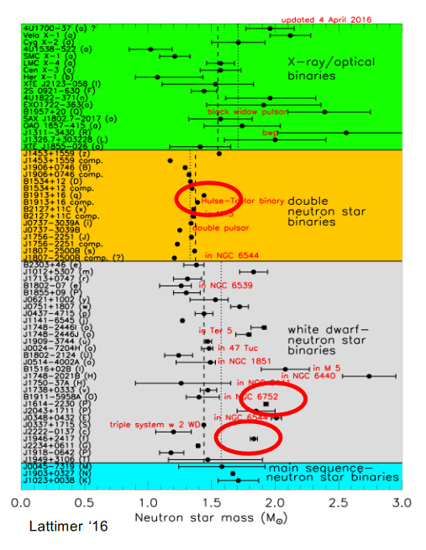
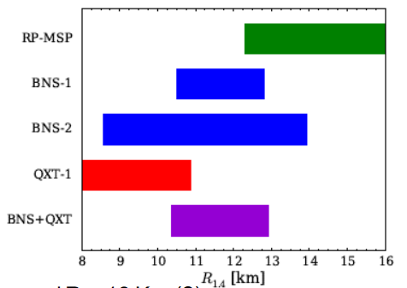
Neutron star Radii and masses
Fontin et al 2015

Slide 5
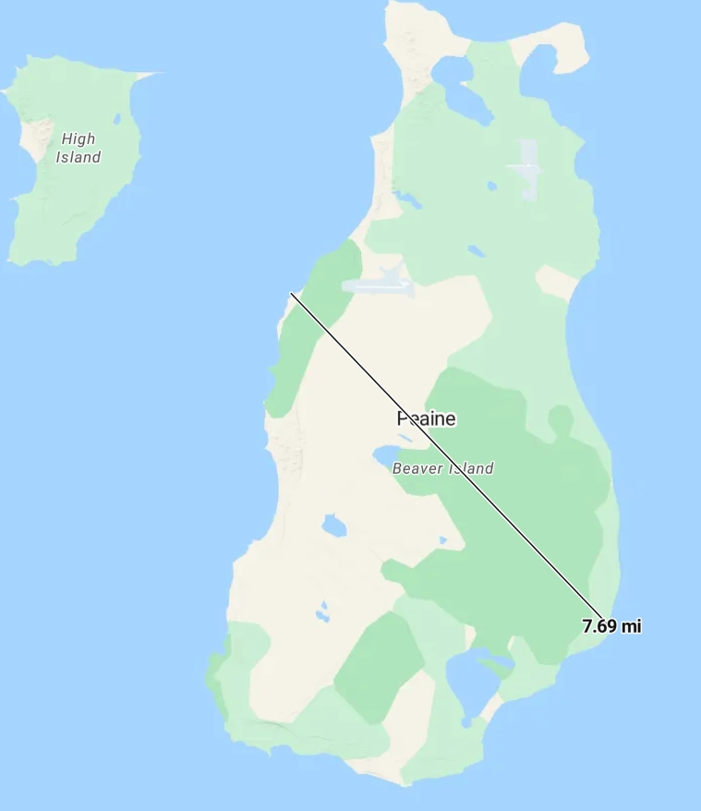
Neutron stars

Slide 6
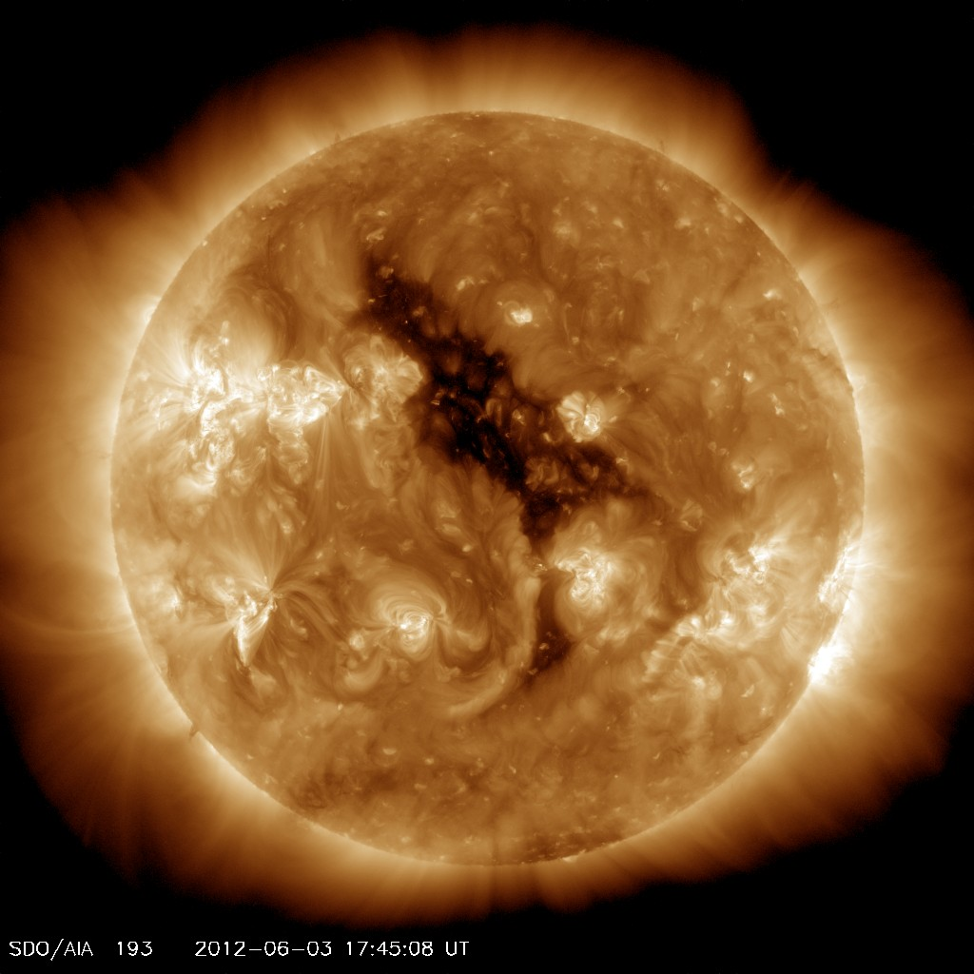
Neutron stars
Density: 10⁹ - 10 ¹⁵ g/cm³ (lead= 11 g/cm³, nuclear =2.3x10¹⁴ g/cm³)

Slide 7
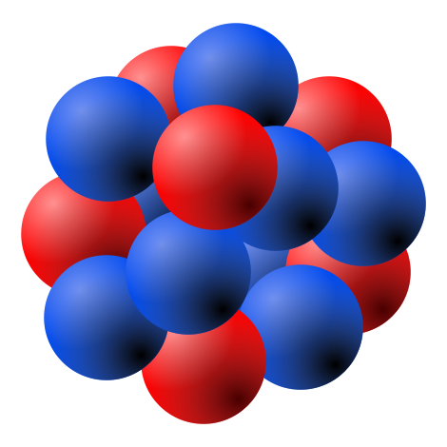
Neutron stars
Density: 10⁹ - 10 ¹⁵ g/cm³ (lead= 11 g/cm³, nuclear =2.3x10¹⁴ g/cm³)

Slide 8
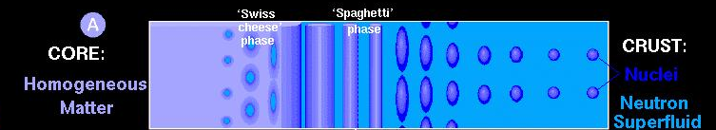
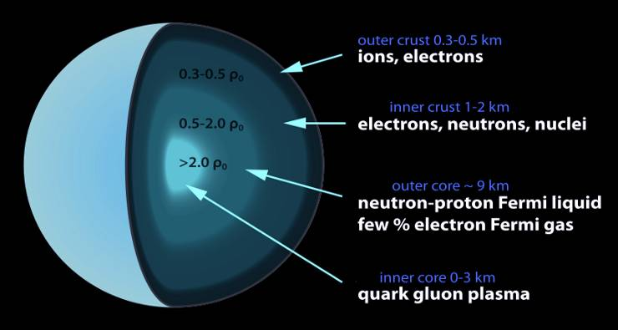
Neutron star structure
Nuclear density
ρ₀=2.3x 10¹⁴ g/cm³

Slide 9
How to study neutron stars as a theoretician?
Burn super computers with simulations
Develop models for selected layers of the star
If so, what degrees of freedom ?

Slide 10
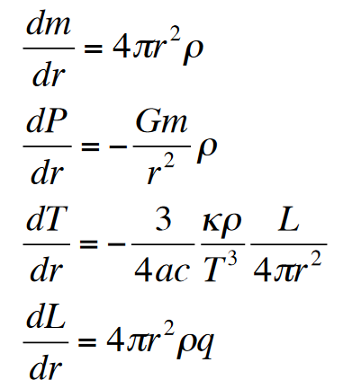
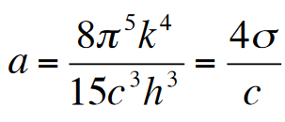
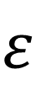
Recall: A very simple model for stellar burning
Mass conservation
Hydrostatic equilibrium
Energy transport
Opacity κ
Energy generation
Rate of energy generation per unit mass: q [erg/g/s]
$$ε$$

Slide 11
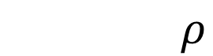
Equation of State (EOS)
PV=nRT Ideal Gas
Polytrope
$$P=Kρ^{n}ρ$$

Slide 12
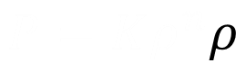
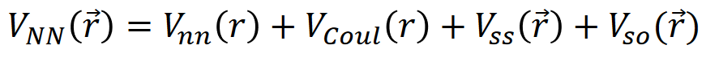
Equation of State (EOS)
PV=nRT Ideal Gas
Polytrope
Modern EOSs depend on nuclear interactions

Slide 13
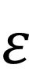
Neutron star at zero temperature
Solve the structure equations:
With polytropic EOS
P= K ρ ^{Γ}
$$ε$$

Slide 14
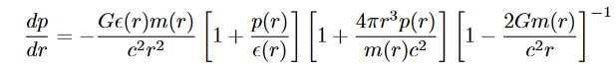
Not there yet...
For very compact objects space-time is changed by the mass distribution
Tolman-Oppenheimer-Volkorov (TOV) Equation
Solve the set of equations with boundary conditions and initial values e.g p₀

Slide 15
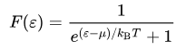
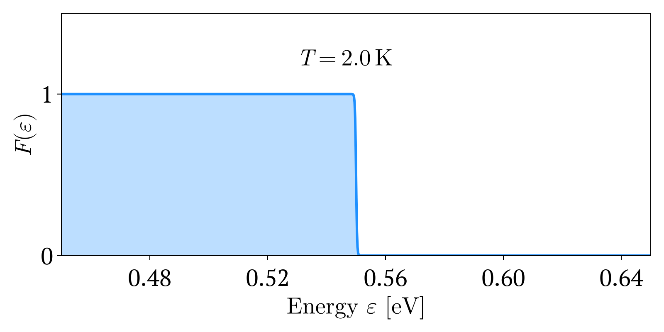
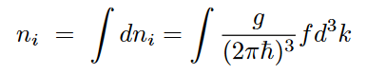
Building a model
Free degenerate neutron gas
Number density
Image from Wikipedia

Slide 16
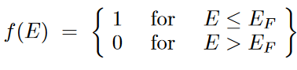
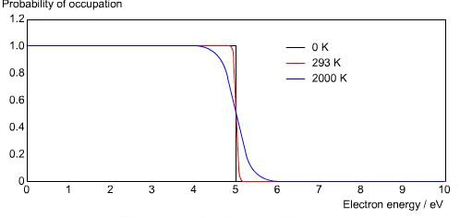
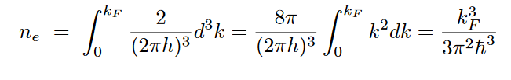
Building a model
Free degenerate neutron gas
Highly degenerate
Image from Wikipedia

Slide 17
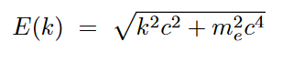
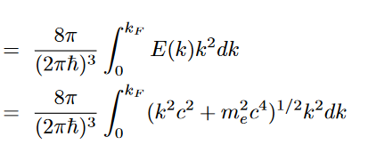
Building a model
Free degenerate neutron gas at T=0
Then the energy density is
ε
Image from Wikipedia

Slide 18
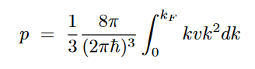
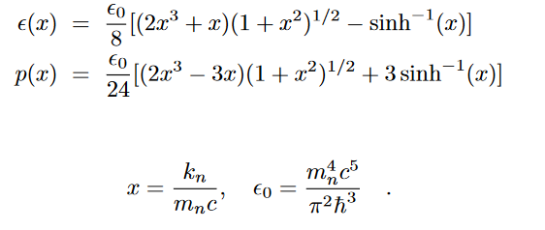
Building a model
Free degenerate neutron gas at T=0
The pressure is :
With a change of variables, we integrate:
F
F
F
F
Image from Wikipedia

Slide 19
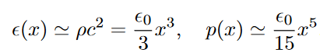
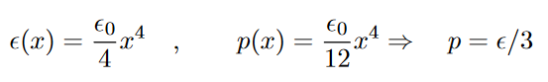
Building a model
Free degenerate neutron gas at T=0
Non-relativistic limit x<<1
F
Ultra relativistic limit x>>1
F

Slide 20
Your turn: find the polytropic index
P= K ρ ^{Γ}

Slide 21
Suggested steps
*Assume an ultra-relativistic limit x>>1, start with the pressure.
*Write the pressure in terms of the Fermi momentum
*Use the relation of the neutron number density to the Fermi momentum k
*Replace in the pressure.
*Done!

Slide 22
Polytropic index Γ?
Free degenerate neutron gas at T=0
The pressure is
Assume all the mass is given by neutrons
Ultra relativistic limit x>>1
F
F
We have found polytropic EOS
P= K ρ ^{Γ}

Slide 23
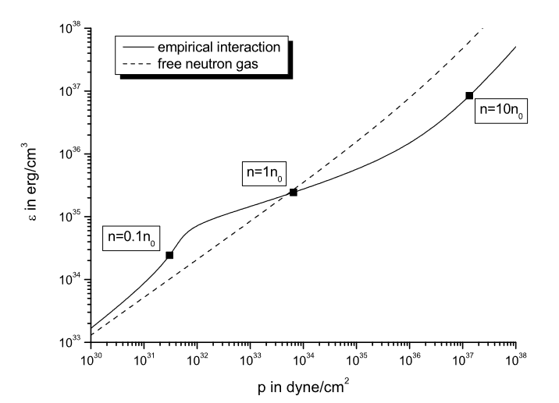
Free gas vs empirical model
The pressure is
With a change of variables, we integrate:
I. Sagert et al 2005: https://arxiv.org/pdf/astro-ph/0506417

Slide 24
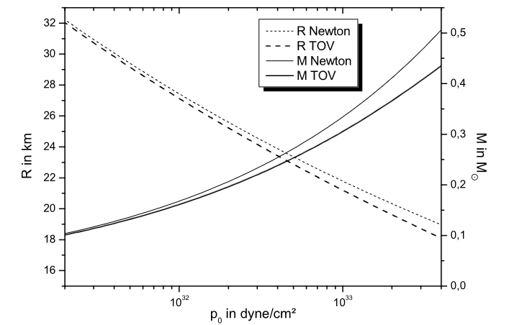
Results
Non-relativistic limit x<<1
I. Sagert et al 2005: https://arxiv.org/pdf/astro-ph/0506417

Slide 25
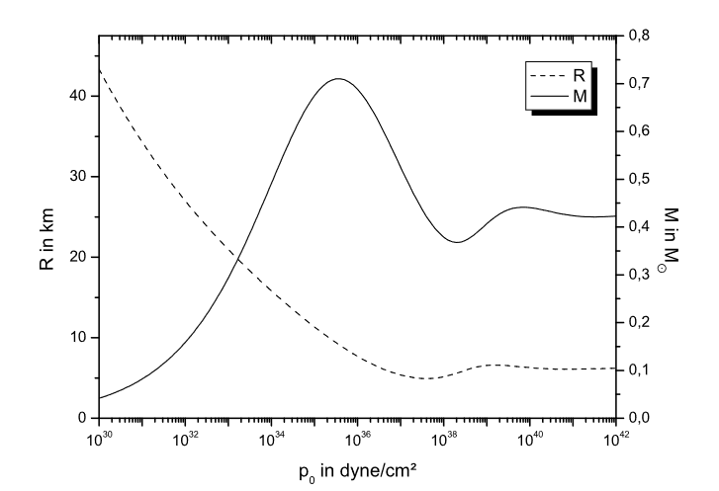
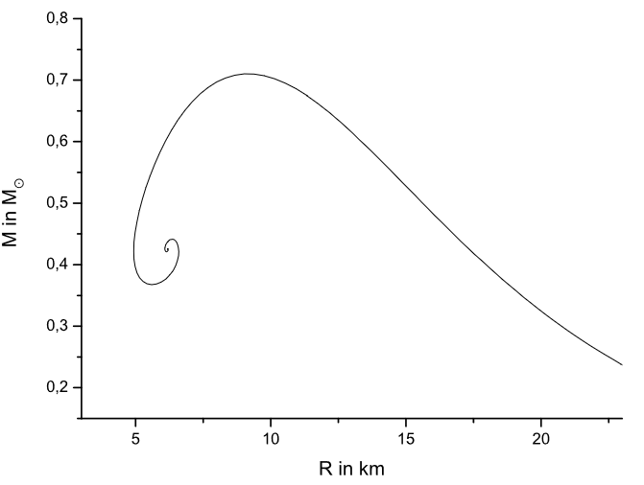
Results
Full relativity range, maxima: M= 0.72 Msun and R=9.14 km
I. Sagert et al 2005: https://arxiv.org/pdf/astro-ph/0506417

Slide 26
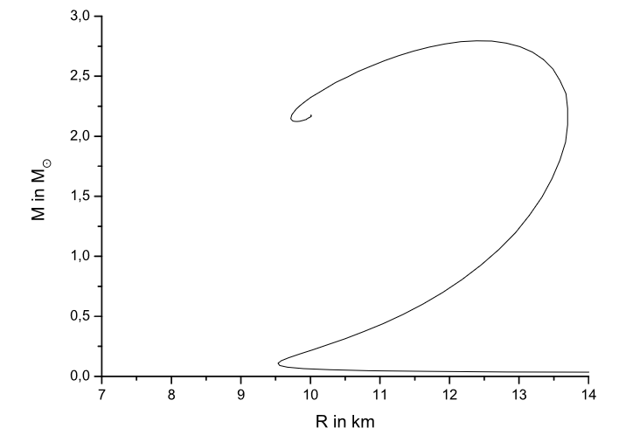
Building a model: empirical interaction
Full relativity range M= 2.792 Msun and R=12.46 km
The pressure is
With a change of variables, we integrate:
I. Sagert et al 2005: https://arxiv.org/pdf/astro-ph/0506417

Slide 27
Building a model: empirical interaction
Full relativity range M= 2.792 Msun and R=12.46 km
The pressure is
With a change of variables, we integrate:
I. Sagert et al 2005: https://arxiv.org/pdf/astro-ph/0506417

Slide 28
Isolated NS: Equation of State (EOS)
NS mass =1.35 solar masses
Statistical model (Hempel et al 2010) with the Relativistic Mean Field interactions:
Max. mass observed by
P. Demorest et al 2010
J. Antoniadis et al 2013
NL3: Lalazissis et al (2008) , stiff
DD2: Typel et al (2012)
SFHo: Steiner et al (2012) , soft
C. Palenzuela et al PRD 2015

Slide 29
Isolated NS: Equation of State (EOS)
Empirical
Realistic
Max. mass observed by
P. Demorest et al 2010
J. Antoniadis et al 2013
I. Sagert et al 2005: https://arxiv.org/pdf/astro-ph/0506417
C. Palenzuela et al PRD 2015

Slide 30
Merger of unequal mass magnetized NSs
(CQG 2016, L. Lehner et al)
q=m₁/m₂
q=1
q<1

Slide 31
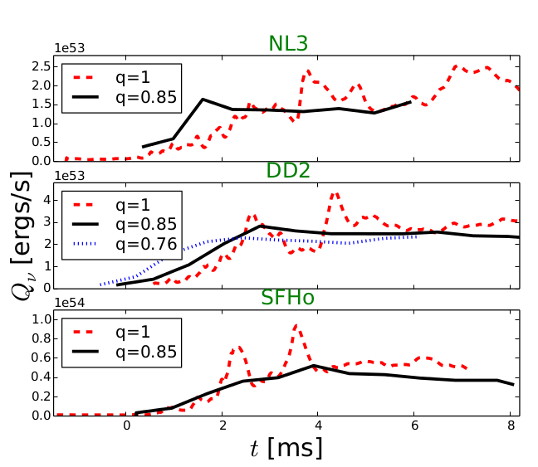
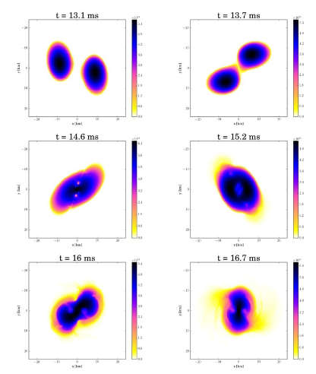
Merger of unequal mass magnetized NSs
(CQG 2016, L. Lehner et al)
Neutrino luminosity evolution
Luminosity oscillates for q=1

Slide 32
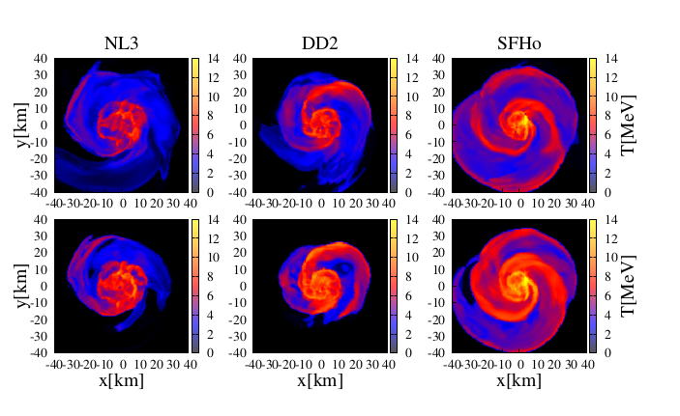
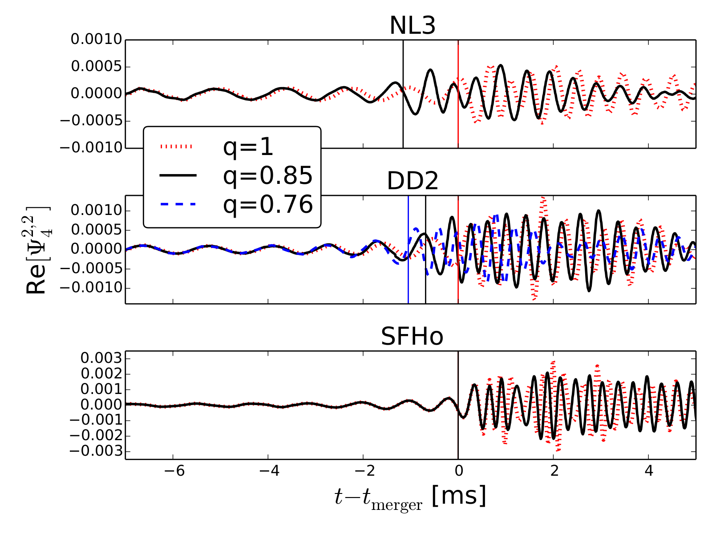
Merger of unequal mass magnetized NSs
(CQG 2016, L. Lehner et al)
q=m₁/m₂
q=0.85
As q decreases the stronger are the tidal effects
Tidal effects are more pronounced with stiffer EoS
Reduction of the mass ratio disrupts the star earlier

Slide 33
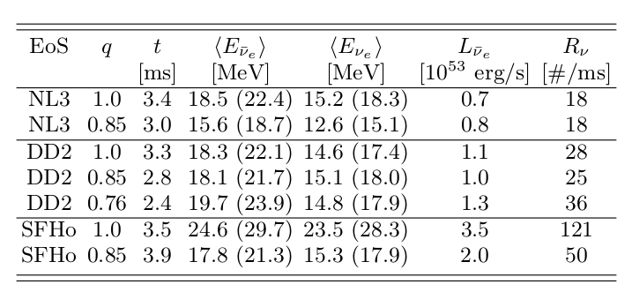
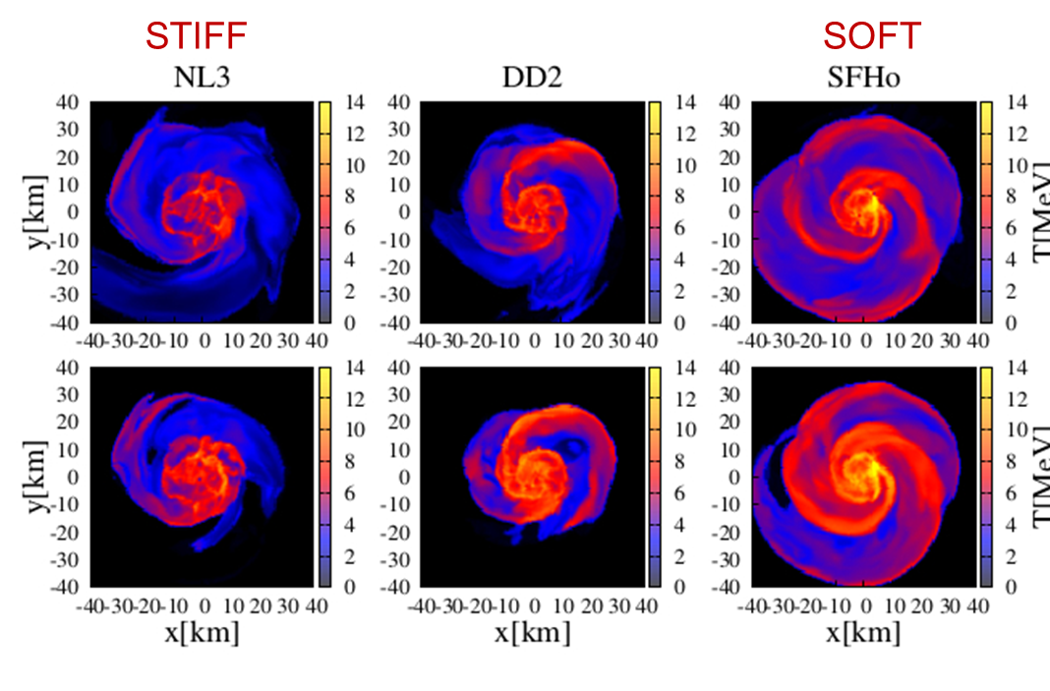

Merger of unequal mass magnetized NSs
Neutrinos in SuperK: NS-NS merger at 10 kpc
Recall SN: 0.01/ms
Larger changes with soft EoS when q decreases
$$R=\frac{N_{T}}{4π}\int_{E_{th}}^{∞}{φ^{eff}\left(E_{ob}\right)σ\left(E_{ob}\right)dE_{ob}}$$

Slide 34
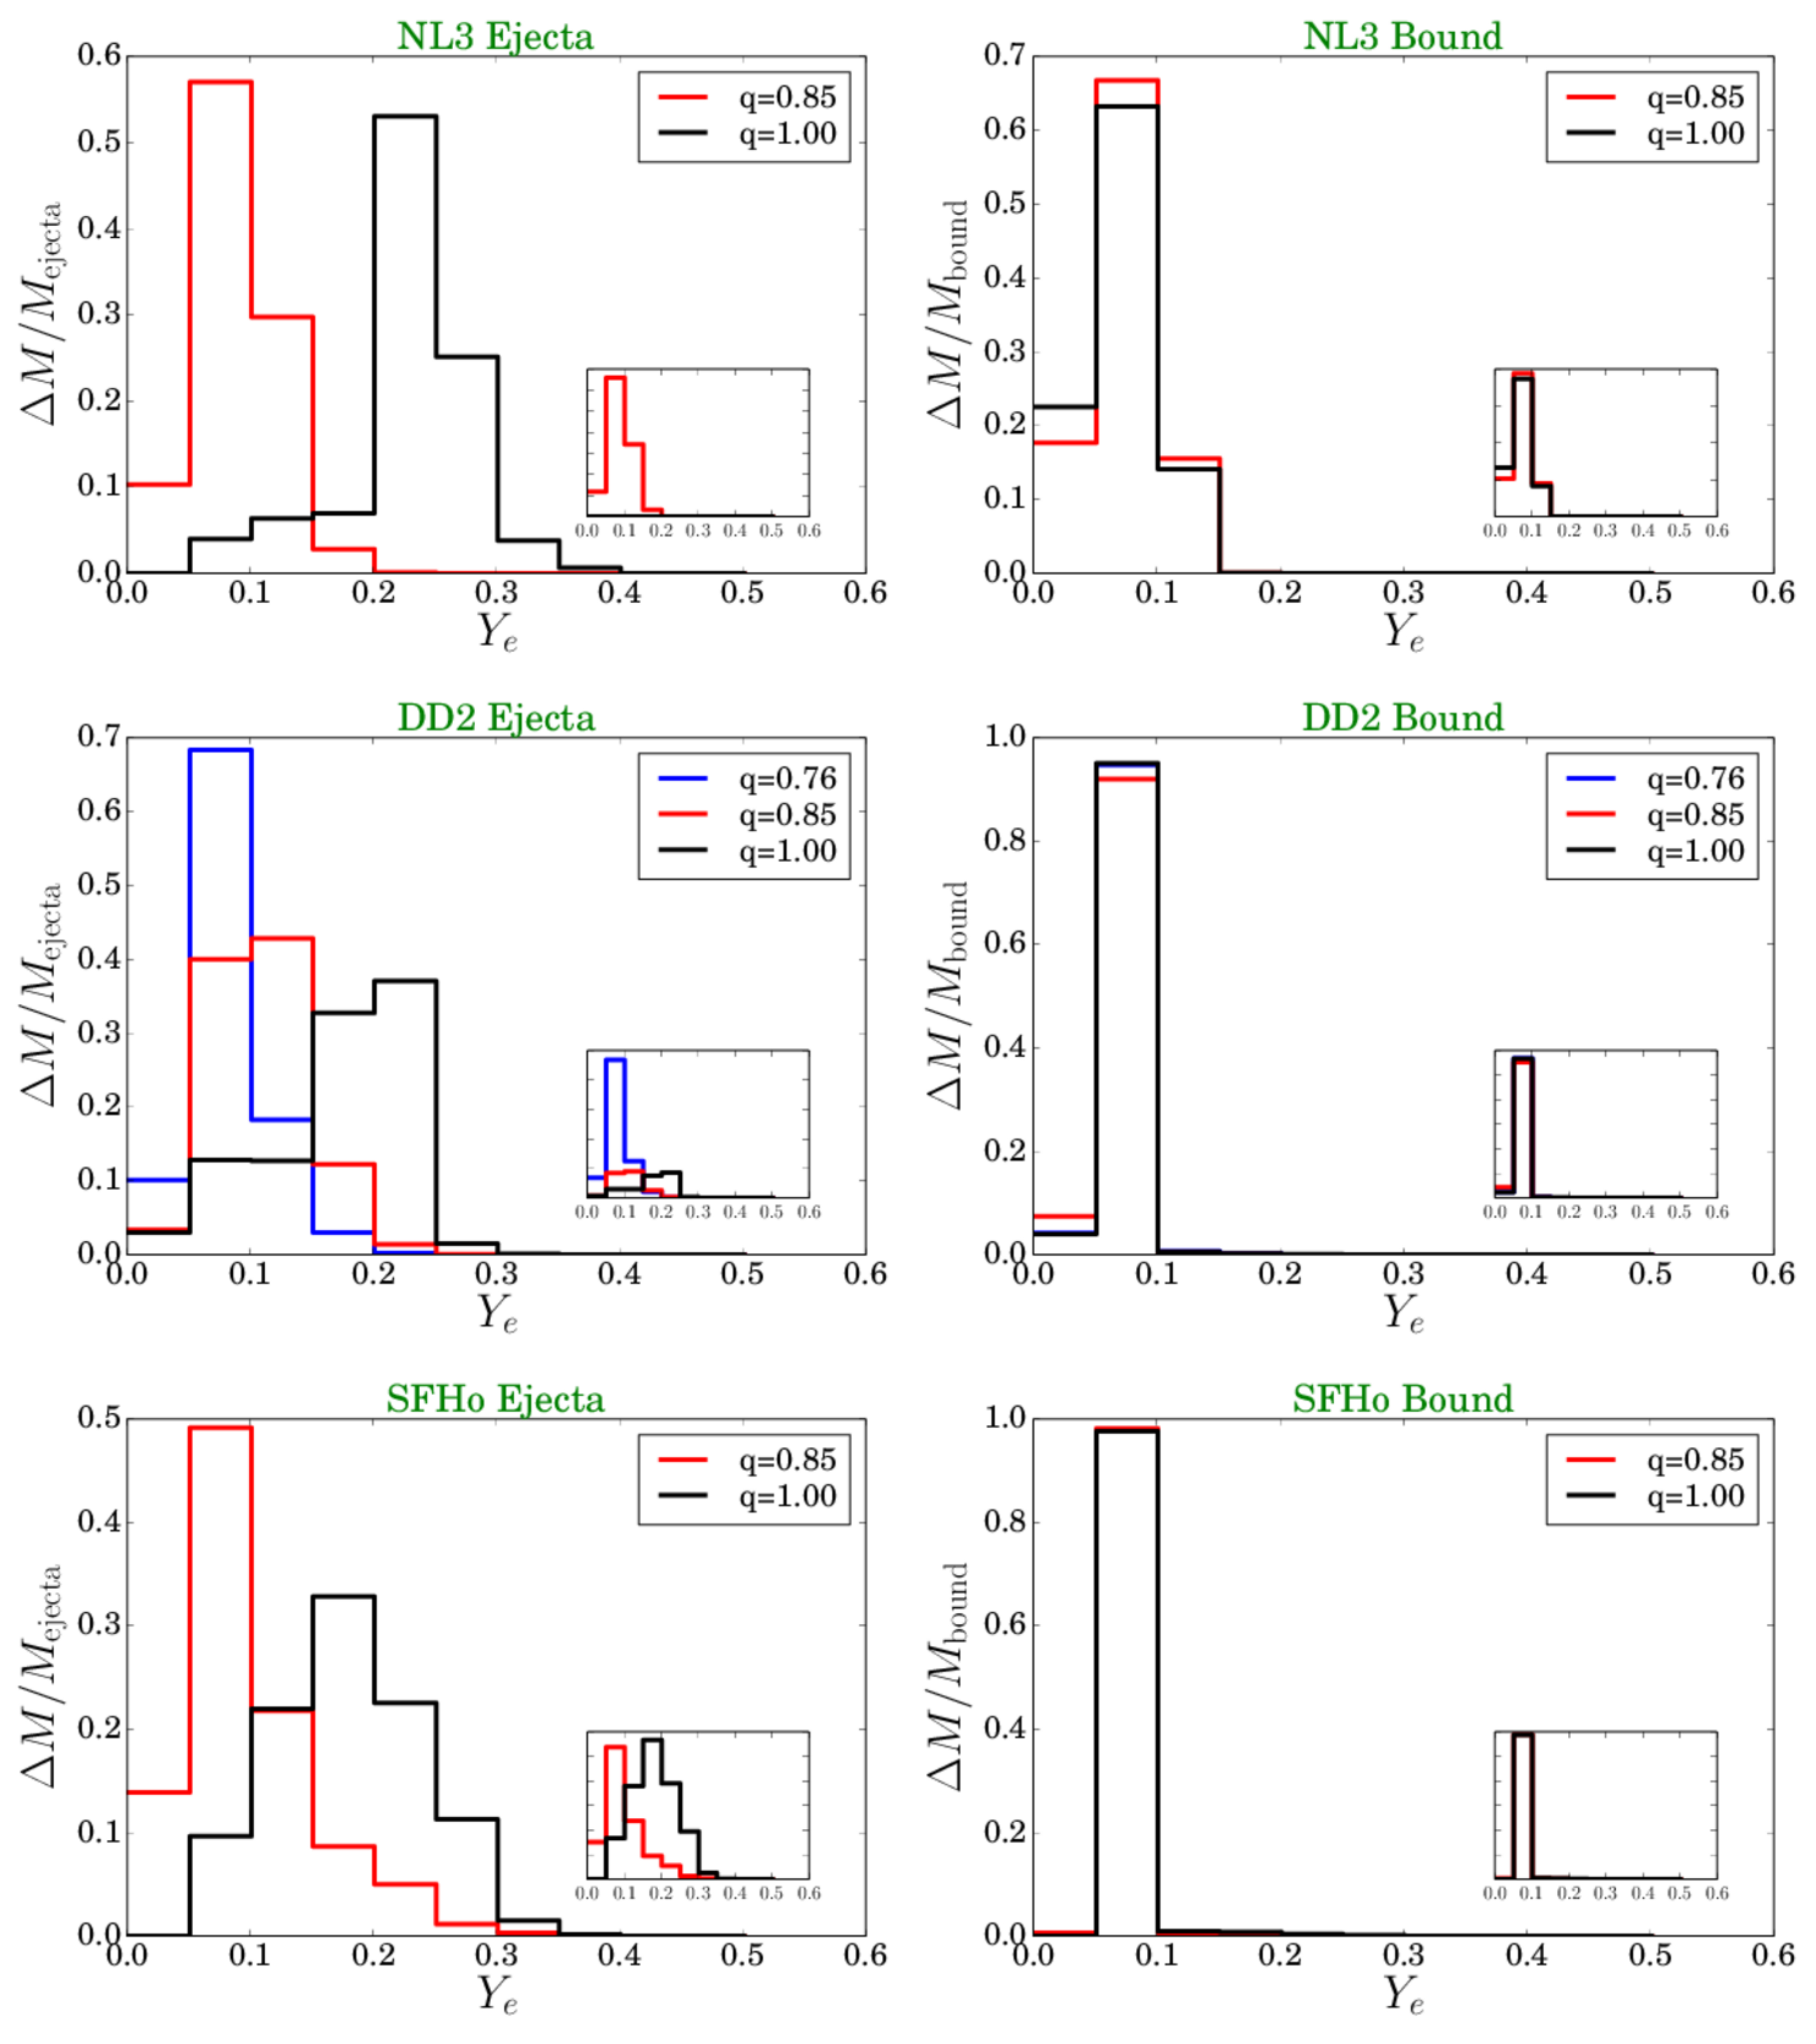
Electron fraction distribution for unbound and bound material
Electron fraction Y_{e} decreases
as q decreases,
compatible with
r-process nucleosynthesis
and kilonova

Slide 35
Take away messages
Realistic equations of state are needed to reproduce observations
Conversely, neutron star observations can help infer nucleon-nucleon interactions, and properties of highly dense nuclear matter
Neutrino observations could aid constraint the EoS
General relativity is mandatory in the modeling of neutron stars
More work needed regarding the different layers of the neutron star

Slide 36
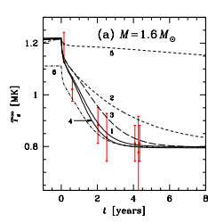
Cooling of accreted Neutron Stars
KS 1731-260
P.S Shternin et al Mon. Not. R. Astron Soc (2007)
Curves 1-4 assume high thermal conductivity (crystal) while 5 low (amorphous)

Slide 37
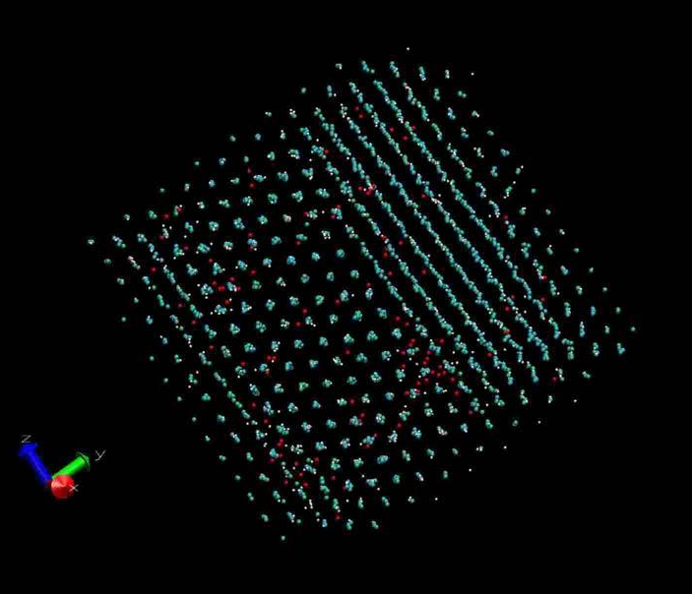
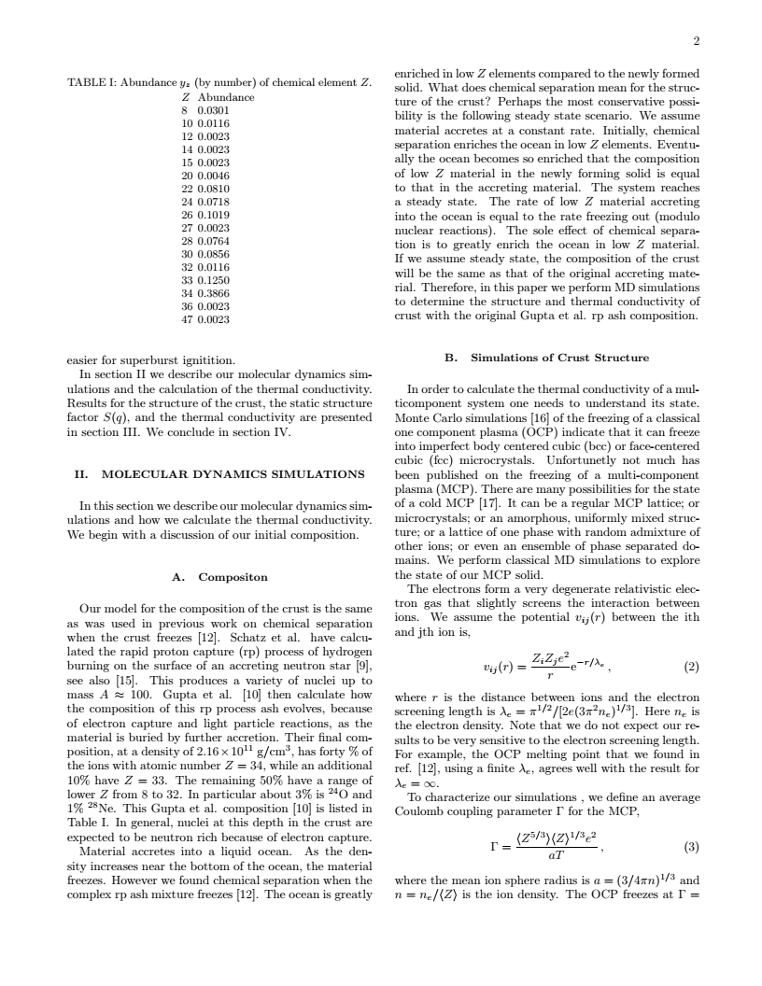
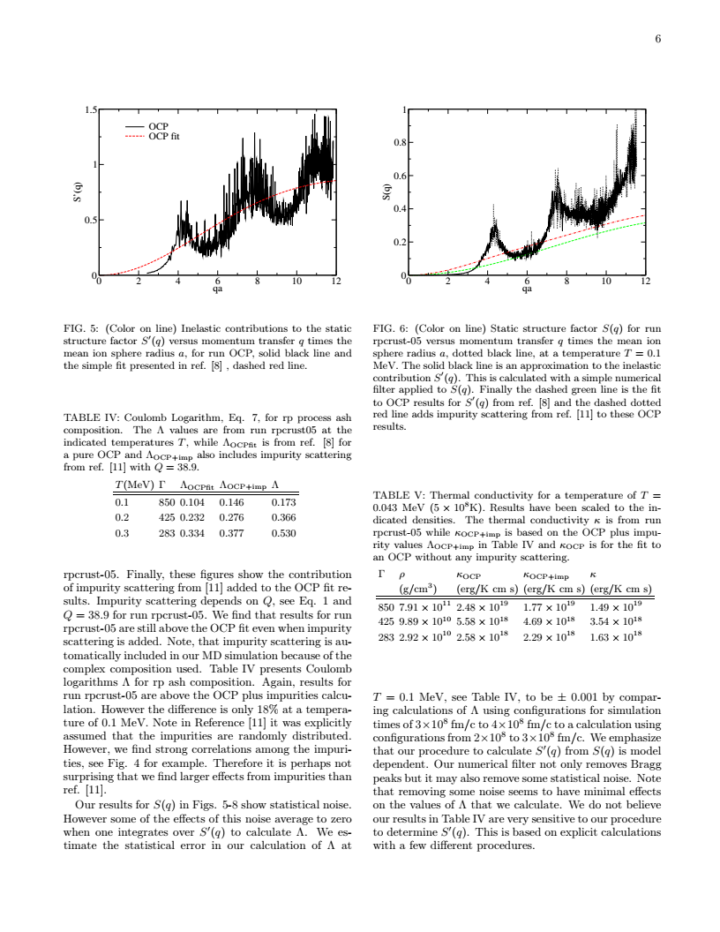
Molecular Dynamic Simulations of NS outer crust
Degenerated relativistic electrons
Ions (x,y,z, V_{x},V_{y},V_{z})
Phase separation: low Z impurities are not uniformly distributed
C. Horowitz, O. L. Caballero, D. Berry, PRE 2009

Slide 38

Simulation of the inner crust: Nuclear Pasta
Frustration
Near saturation density:
Short range attractive nuclear force
Long range repulsive Coulomb Force
D. G. Ravenhall, C. J. Pethick, and J. R. Wilson,PRL 50 (1983)
MD simulations C. Horowitz, A. Perez-Garcia, J. Piekarewicz PRC 2004,
QMD simulations Watanabe et al PRC 2002
HF simulations P. Gogelein and H. Muther PRC 2007

Slide 39
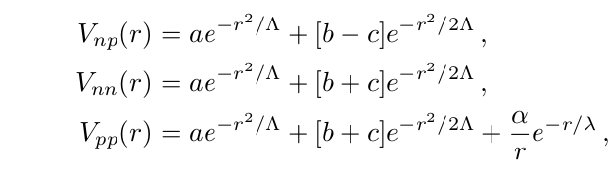
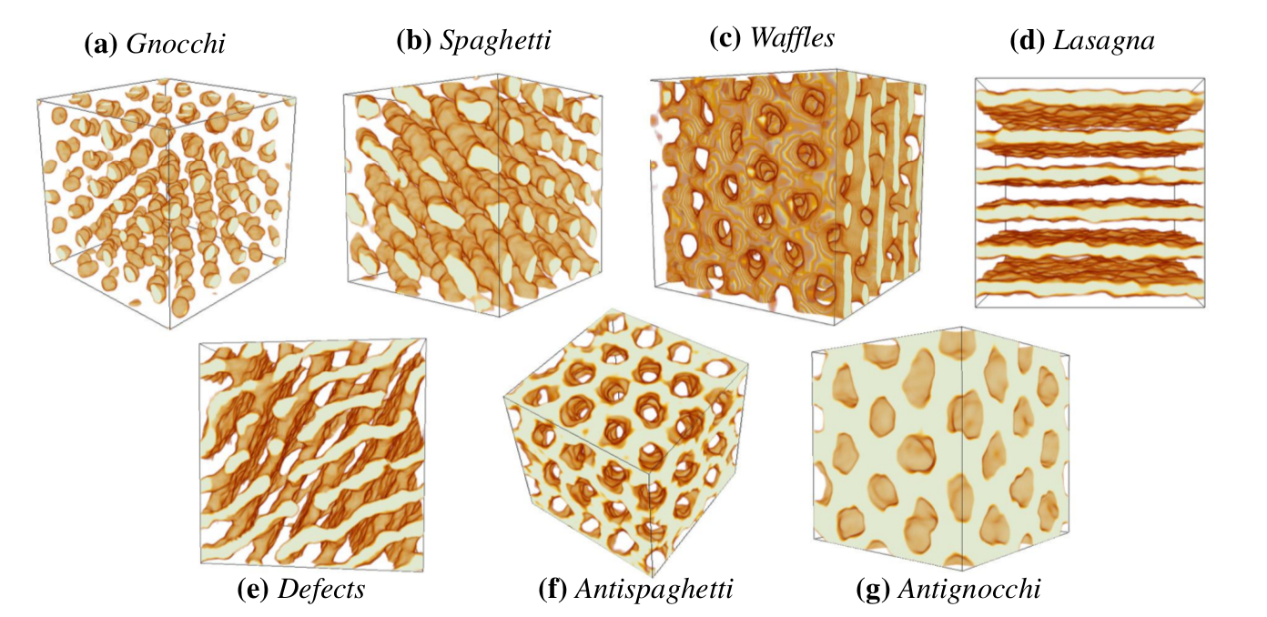
Molecular dynamics simulations: Nuclear Pasta
Two-body potentials
a,b,c, Λ are chosen to reproduce eg. binding energies
Caplan & Horowitz, Rev.Mod.Phys. 89 (2017)

